Slide 1
Introduction Database checkpoint
MySQL, PostgreSQL and SQL SERVER

Slide 2
MySQL
Is an open-source relational database management system (RDBMS), developed by Oracle that is based on structured query language (SQL).
A database is a structured collection of data. It may be anything from a simple shopping list to a picture gallery or a place to hold the vast amounts of information in a corporate network.

Slide 3
PostgreSQL
PostgreSQL is a powerful, open source object-relational database system with over 30 years of active development that has earned it a strong reputation for reliability, feature robustness, and performance.
It supports both SQL (relational) and JSON (non-relational) querying. ... PostgreSQL is used as the primary data store or data warehouse for many web, mobile, geospatial, and analytics applications. The latest major version is PostgreSQL 12.

Slide 4
SQL Server
SQL Server is a database management system (DBMS) in SQL language incorporating, among other things, an RDBMS (relational DBMS ") developed and marketed by the Microsoft company. It works on Windows and Linux OS (since March 2016), but it is possible to launch it on Mac OS via Docker, because there is a version for download on the Microsoft website2.

Slide 5
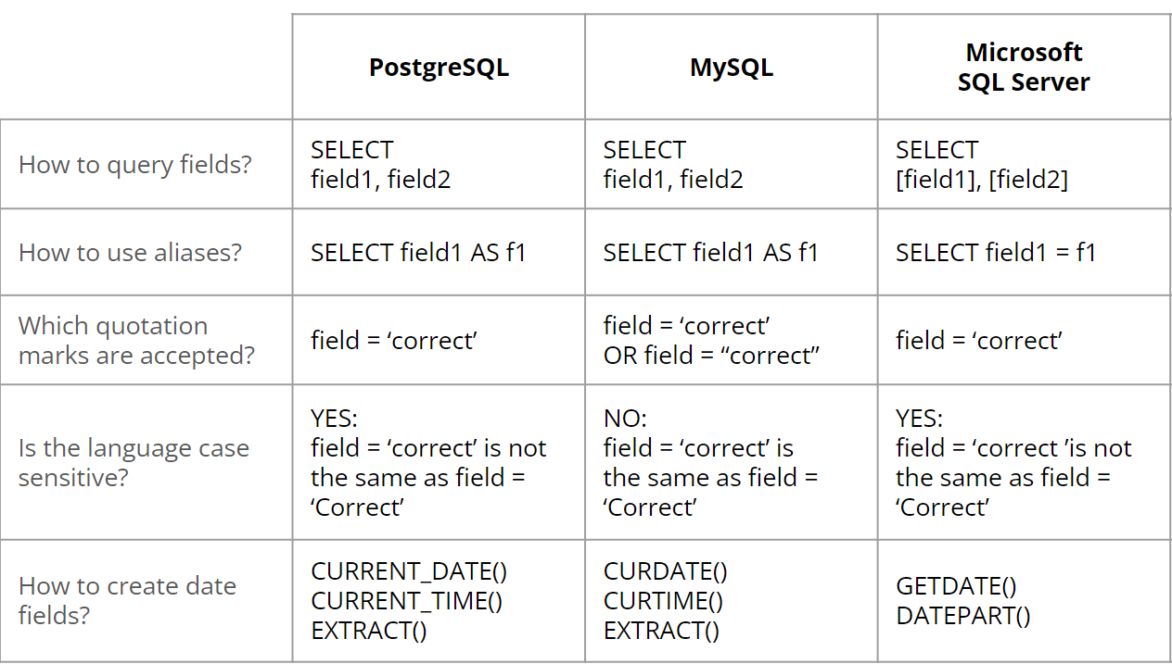
A comparison between the three RDBMS

Slide 6
Thanks for your attention.

